Slide 1
Policy Gradient Methods
Lecture 8
Subir Varma

Slide 2
Last Lecture
Output: Q Function for
Actions in state S
Input: State S
Q(S,A₁,W)
S
Q(S,A_{K},W)
W
Policy Function
Focus was on Value Function Approximations
Policy was generated indirectly by taking the max of the Q functions

Slide 3
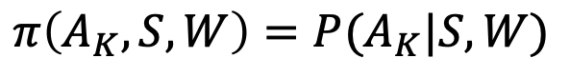
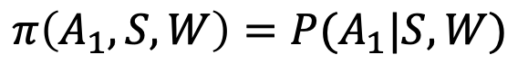
This Lecture
Output: Probability Distribution for
Actions in state S
Input: State S
$$π\left(A_{1},S,W\right)=P(A_{1}|S,W)$$
S
w
$$π\left(A_{K},S,W\right)=P(A_{K}|S,W)$$
Generate the Optimal Policy Directly without using Q Functions

Slide 4
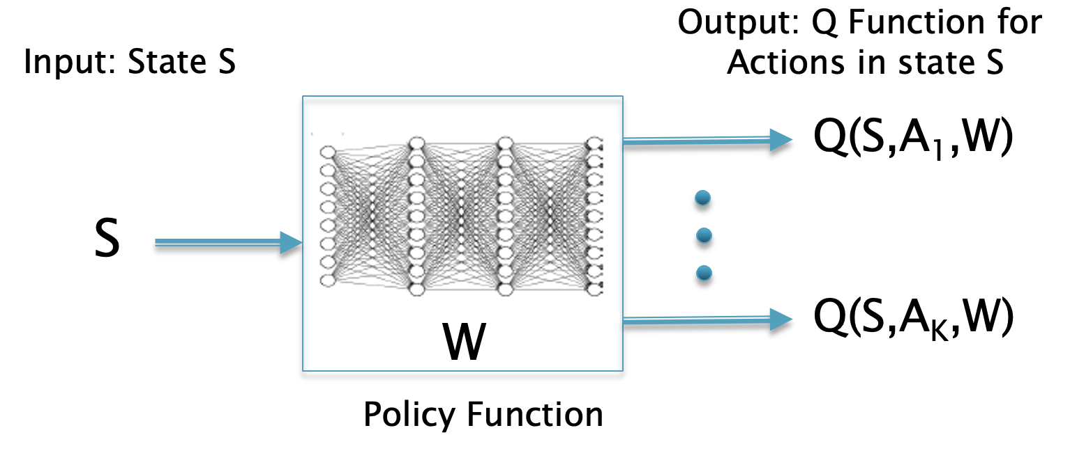
How to Train the Policy Network?
Basic Issue:
What Reward Function should we use for the
Policy Network such that it outputs the Optimal Policy

Slide 5
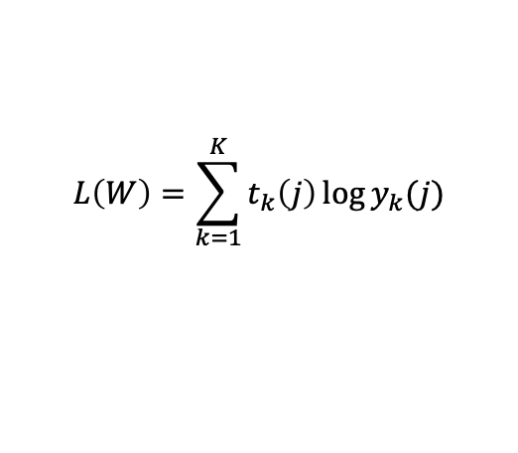
Reward Functions
Three Techniques:
The Reinforce Algorithm (also called Policy Gradients)
R = G(S)L, where G is the Reward to Go and L is the Reward Function used in Logistic Regression
Works only for MDPs with terminating Episodes
Actor-Critic Algorithms
R = r + V_{w}(S) – V_{w}(S’), where r is the 1-step Reward and V_{w} is the NN computed Value Function for the MDP
Works for non-terminating MDPs
Deterministic Policy Gradients Algorithm
R = Q_{w}(S,A), where Q_{w}(S,A) is the NN computed Q function for the MDP
Works for continuous Action Spaces
$$L\left(W\right)=\sum_{k=1}^{K}{t_{k}\left(j\right)\log{y_{k}(j)}}$$

Slide 6
Value Based and Policy Based RL
MC
SARSA
Q-Learning
DQN
Reinforce

Slide 7
Pros and Cons of Policy Based RL
Typically required 10x the number of episodes to converge compared to DQN

Slide 8
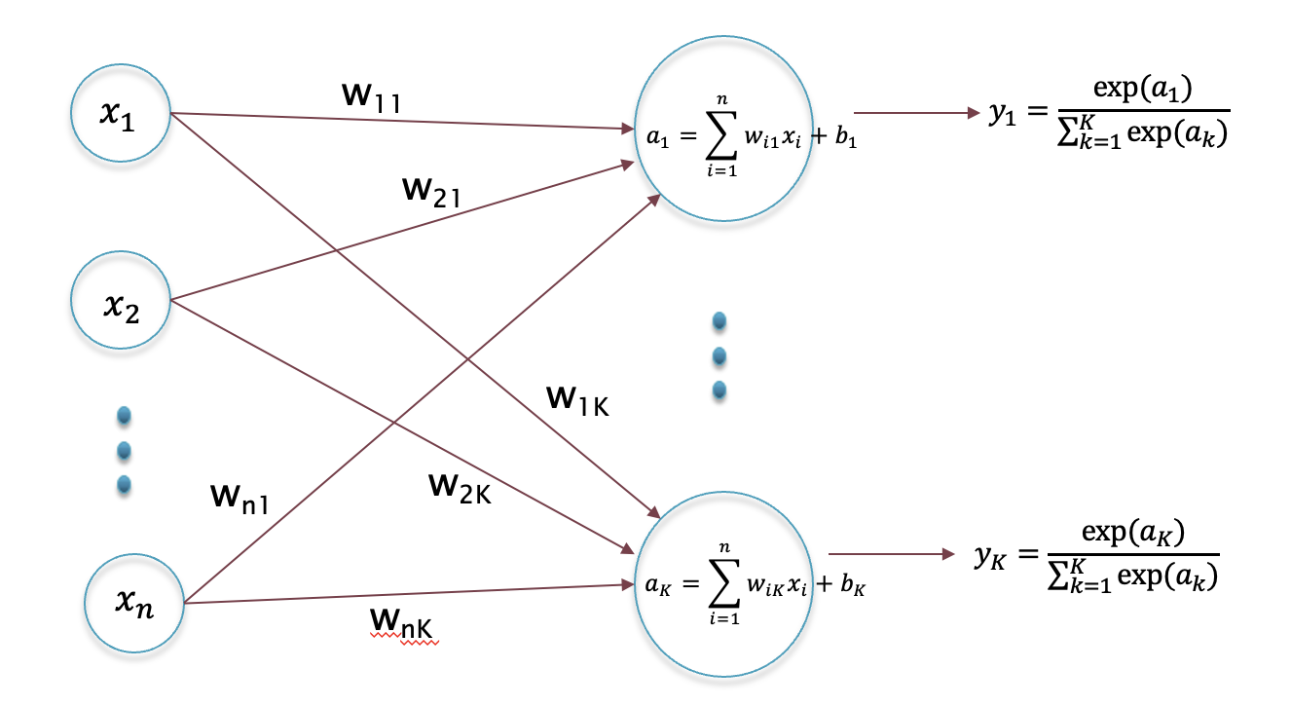
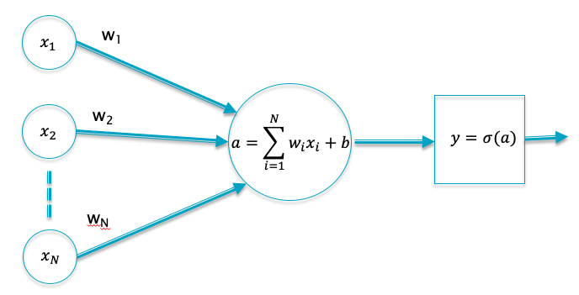
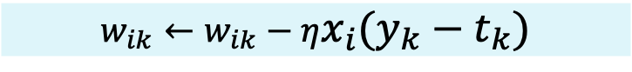
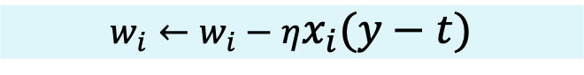
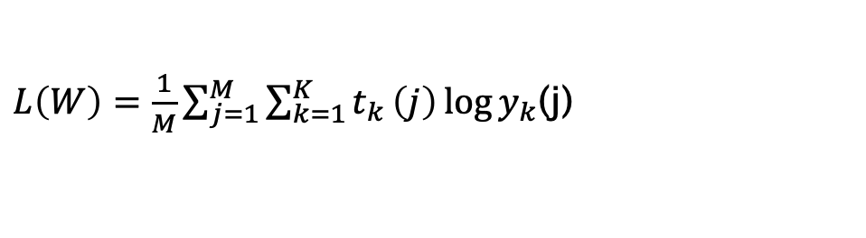
Logistic Regression
Choose weights to
Maximize Reward
$L\left(W\right)=\frac{1}{M}\sum_{j=1}^{M}{\sum_{k=1}^{K}{t_{k}}}\left(j\right)\log{y_{k}}$(j)
$$w_{i}←w_{i}−ηx_{i}(y−t)$$
$$w_{ik}←w_{ik}−ηx_{i}(y_{k}−t_{k})$$

Slide 9
The Policy Gradient Algorithm (Reinforce)

Slide 10
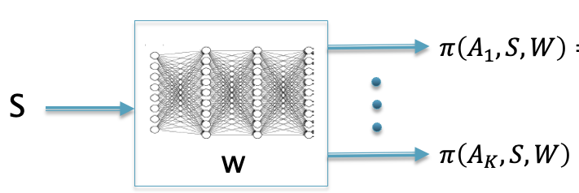
Basic Idea behind Policy Gradients
$$π\left(A_{1},S,W\right)=P(A_{1}|S,W)$$
S
w
$$π\left(A_{K},S,W\right)=P(A_{K}|S,W)$$
Problem: We want to find a Neural Network whose output gives the
Optimal Policy that maximizes the RL Reward R
Solution: Find a Reward Function R’ for the Neural Network, such that the the weights W that maximize R’ also result in the Optimal Policy for the RL problem
Reward R
Reward R’

Slide 11
Playing Pong using Policy Gradients

Slide 12
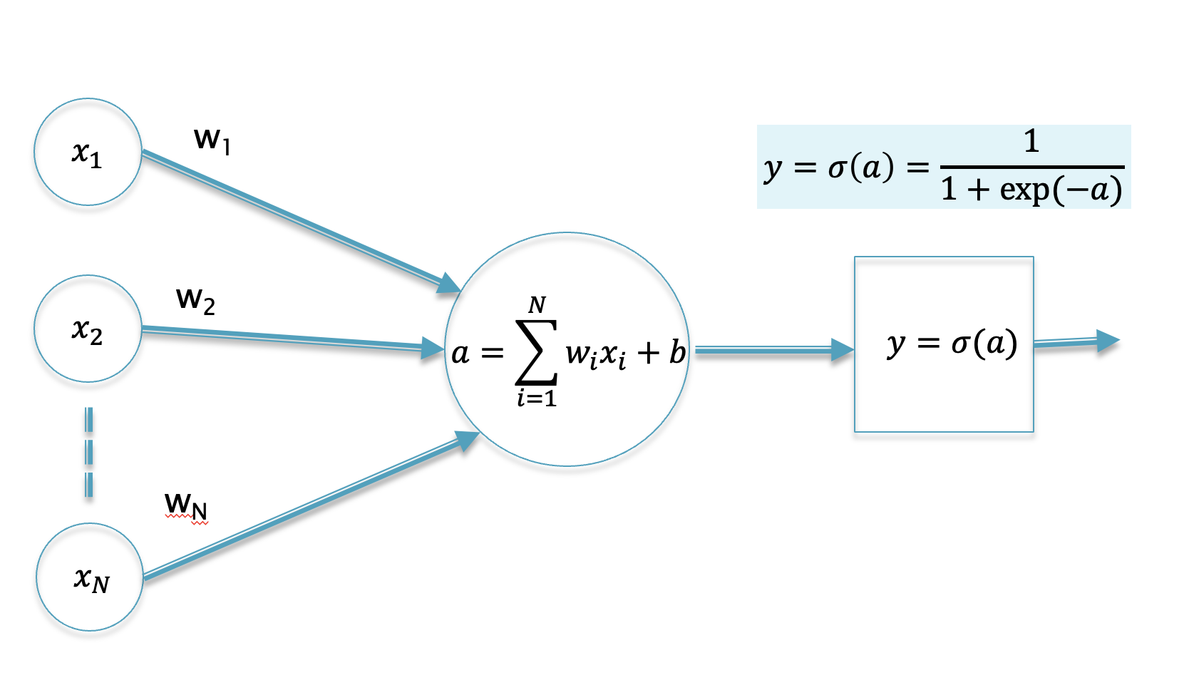
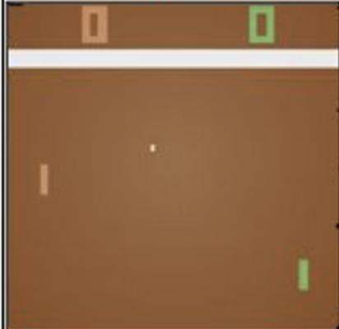
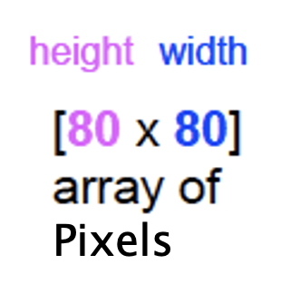
Policy Network for Pong
y = Probability of moving the paddle UP

Slide 13
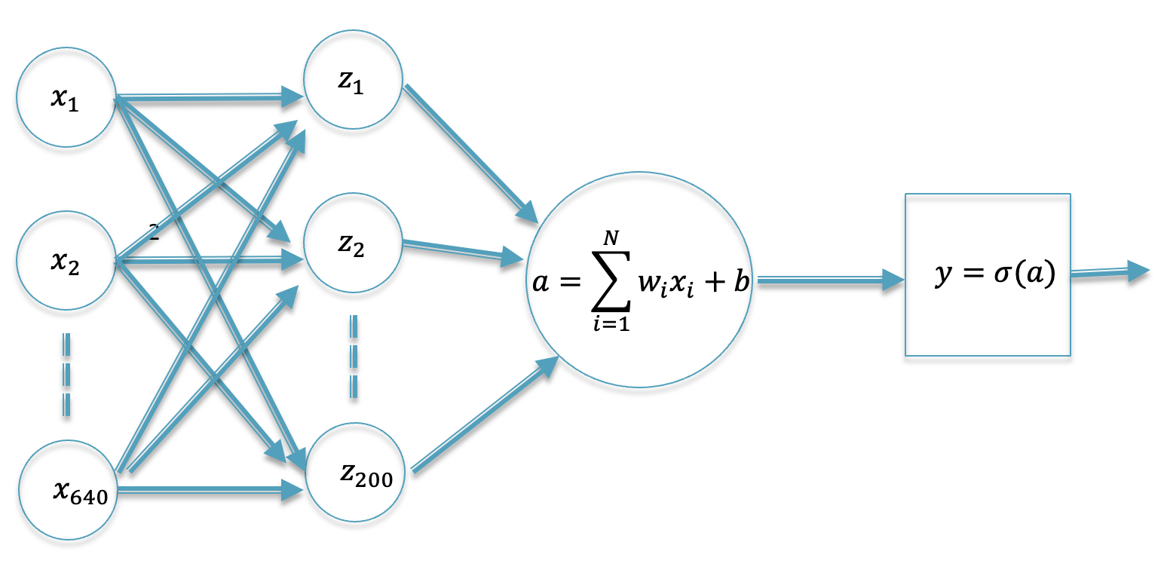
Policy Network for Pong
y = Probability of moving the paddle UP

Slide 14
Policy Network for Pong

Slide 15
Policy Network for Pong
Neural Network with a
single Hidden Layer
Game Screen
Pixels

Slide 16
Training Using
Supervised Learning

Slide 17
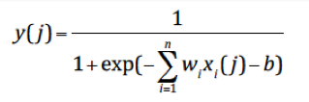
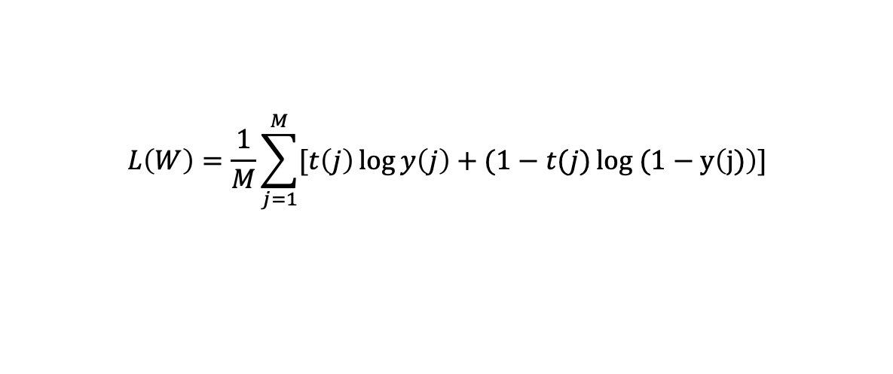
Labels
t = 1, UP
t = 0, DOWN
Maximize
Label
Network Output
$$L\left(W\right)=\frac{1}{M}\sum_{j=1}^{M}{[t\left(j\right)\log{y\left(j\right)+(1−t(j)}}log (1−y\left(j)\right)]$$
Can’t use Supervised Learning

Slide 18
As given by the Neural Network
Actions are sampled
from Network Output

Slide 20
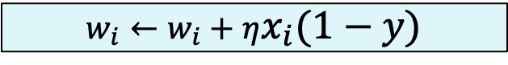
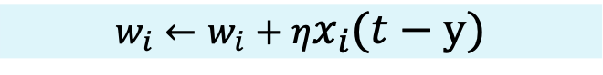
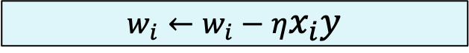
Assume that Every Action we took was correct!
Recall from Lecture 6: We can increase the probability of Action 1 by changing the weights as per
And we can increase the probability of Action 0 by changing the weights as per
$$w_{i}←w_{i}+ηx_{i}(1−y)$$
$$w_{i}←w_{i}−ηx_{i}y$$
$$w_{i}←w_{i}+ηx_{i}(t−y)$$

Slide 21
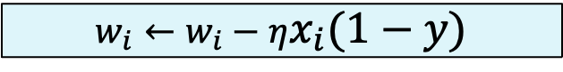
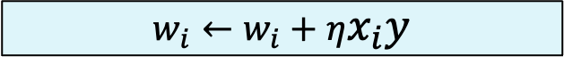
Assume that Every Action we took was incorrect!
Recall from Lecture 6: We can decrease the probability of Action 1 by changing the weights as per
And we can decrease the probability of Action 0 by changing the weights as per
$$w_{i}←w_{i}−ηx_{i}(1−y)$$
$$w_{i}←w_{i}+ηx_{i}y$$
$$w_{i}←w_{i}+ηx_{i}(t−y)$$

Slide 22
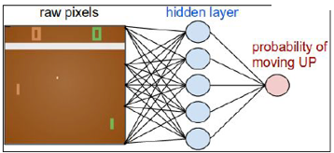
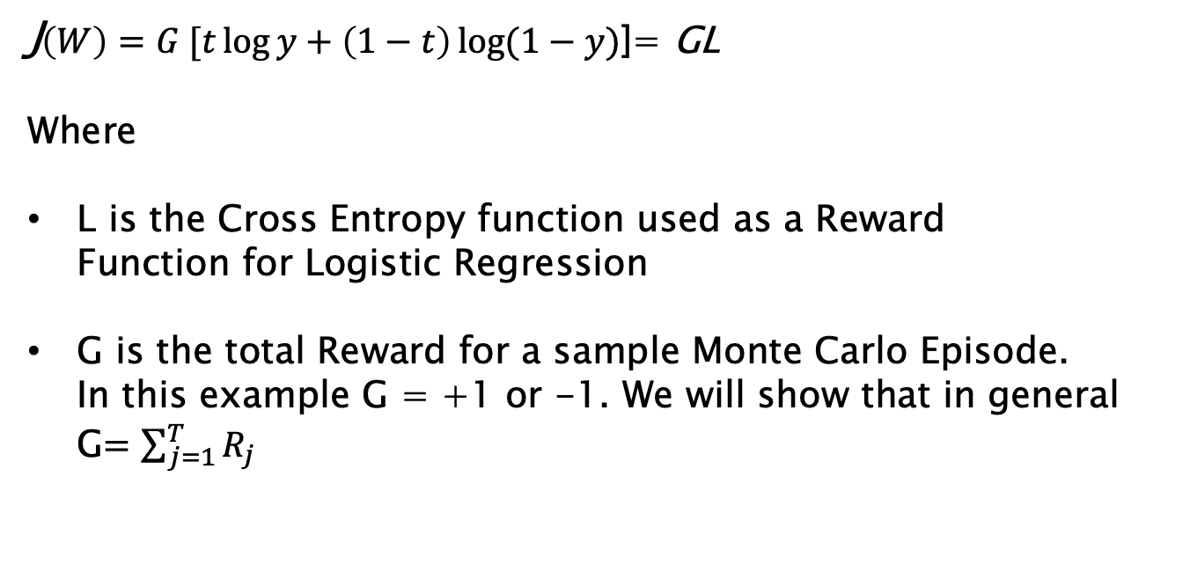
Effectively, we are maximizing
J$\left(W\right)=G [t\log{y+\left(1−t\right)\log{(1−y)}}$]= GL
Where
L is the Cross Entropy function used as a Reward Function for Logistic Regression
G is the total Reward for a sample Monte Carlo Episode. In this example G = +1 or -1. We will show that in general G$=\sum_{j=1}^{T}{R_{j}}$

Slide 23
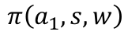
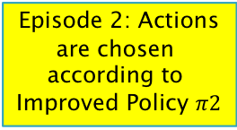
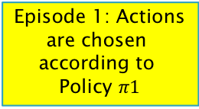
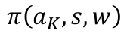
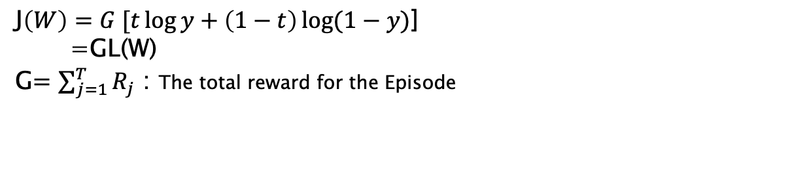
Monte Carlo Policy Gradients: Reinforce
w$←w+η\frac{∂J}{∂w}$= $w+ηG\frac{∂L}{∂w}$
Use these actions as labels to train Policy Network
a₁
Episode 1: Actions are chosen
according to
Policy $π1$
a₂
Episode 2: Actions are chosen
according to
Improved Policy $π2$
a₃
$$π\left(a_{1},s,w\right)$$
J$\left(W\right)=G [t\log{y+\left(1−t\right)\log{(1−y)}}$]
=GL(W)
G$=\sum_{j=1}^{T}{R_{j}}$ : The total reward for the Episode
S
$$π\left(a_{K},s,w\right)$$
Choose Weights to Maximize GL(W)

Slide 24
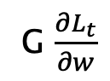
The Reinforce Algorithm
G $\frac{∂L_{t}}{∂w}$
Compute gradient using action a_{t} as the Label at time t
Total Reward for the Episode

Slide 25
Derivation of Likelihood Ratio Formula

Slide 26
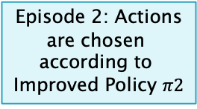
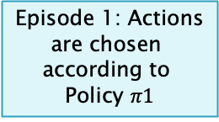
Monte Carlo: Policy Gradients
w$←w+η\frac{∂J}{∂w}$
Episode 1: Actions are chosen
according to
Policy $π1$
Episode 2: Actions are chosen
according to
Improved Policy $π2$
$$π\left(a_{1},s,w\right)$$
S
$$π\left(a_{K},s,w\right)$$

Slide 27
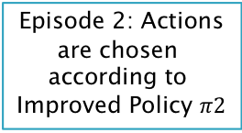
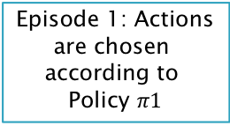
Monte Carlo: Policy Gradients
w$←w+η\frac{∂J}{∂w}$
Episode 1: Actions are chosen
according to
Policy $π1$
Episode 2: Actions are chosen
according to
Improved Policy $π2$
What is an appropriate
Reward Function J for the Policy Network?
$$π\left(a_{1},s,w\right)$$
If we change the parameters w to optimize J, then the Policy should improve.
S
$$π\left(a_{K},s,w\right)$$

Slide 28
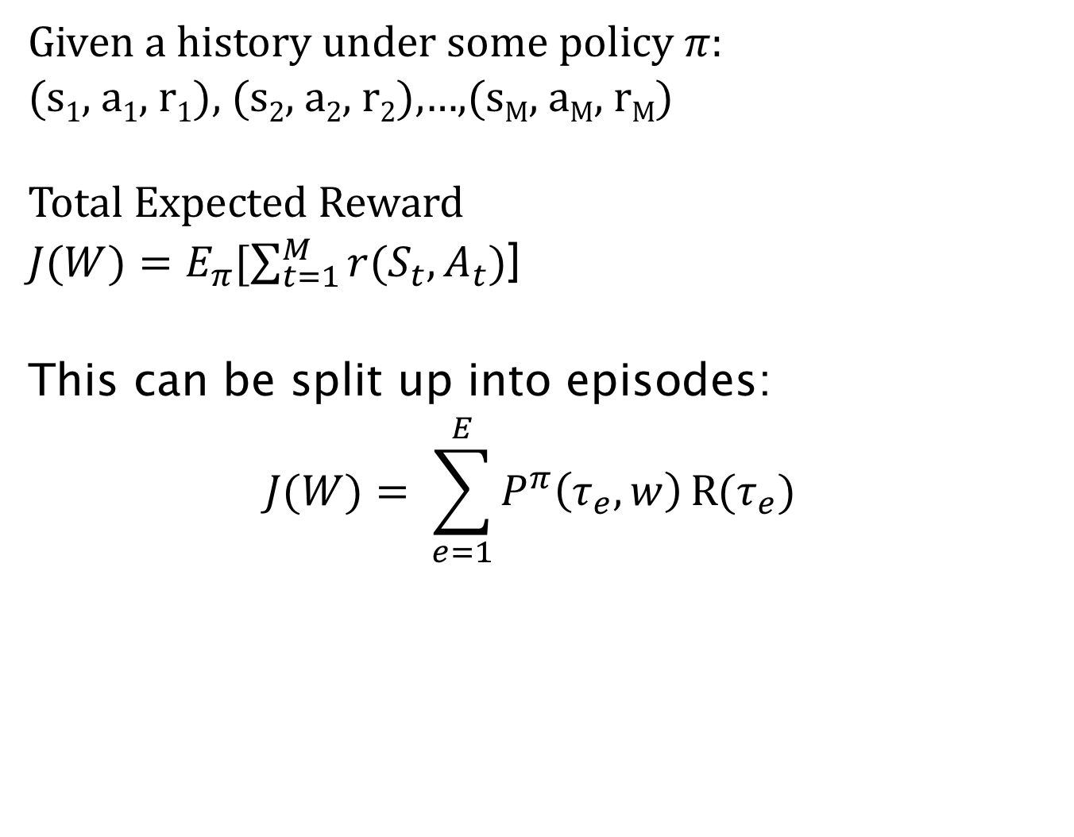
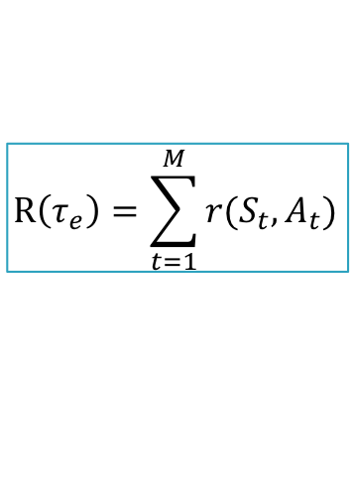
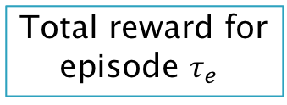
Reward Function for Policy Network
Given a history under some policy $π$: (s₁, a₁, r₁), (s₂, a₂, r₂),…,(s_{M}, a_{M}, r_{M}) Total Expected Reward
$J(W)=E_{π}[\sum_{t=1}^{M}{r(S_{t},A_{t})}$]
This can be split up into episodes:
$$J(W)= \sum_{e=1}^{E}{P^{π}\left(τ_{e},w\right)}R(τ_{e})$$
$$R\left(τ_{e}\right)=\sum_{t=1}^{M}{r(S_{t},A_{t})}$$
Total reward for
episode $τ_{e}$
Probability of generating episode $τ_{e}$ under Policy $π$

Slide 29
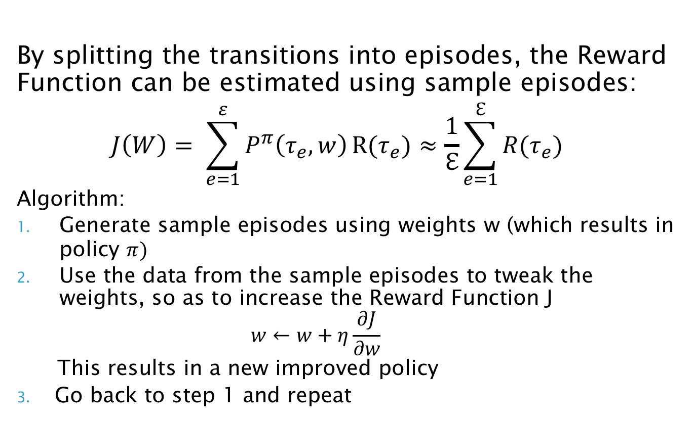
Reward Function for Policy Network
By splitting the transitions into episodes, the Reward Function can be estimated using sample episodes:
$$J\left(W\right)= \sum_{e=1}^{ε}{P^{π}\left(τ_{e},w\right)}R(τ_{e})≈\frac{1}{ℇ}\sum_{e=1}^{ℇ}{R(τ_{e})}$$
Algorithm:
Generate sample episodes using weights w (which results in policy $π)$
Use the data from the sample episodes to tweak the weights, so as to increase the Reward Function J $w←w+η\frac{∂J}{∂w}$
This results in a new improved policy
Go back to step 1 and repeat
How do we compute
this gradient ??

Slide 30
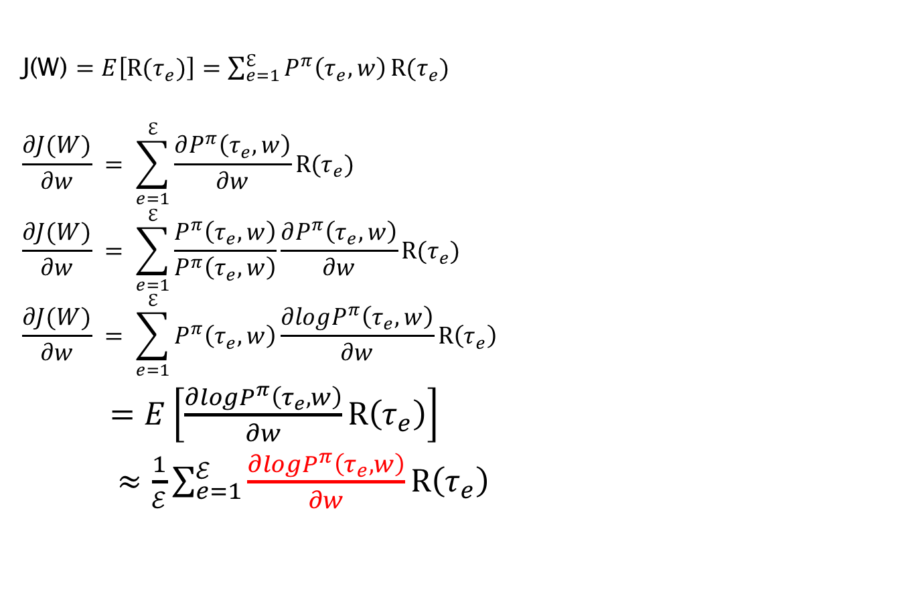
Estimating the Reward Gradient from Sample Episodes
J(W) $=E\left[R(τ_{e})\right]=\sum_{e=1}^{ℇ}{P^{π}\left(τ_{e},w\right)}R(τ_{e})$
$$\frac{∂J(W)}{∂w} = \sum_{e=1}^{ℇ}{\frac{∂P^{π}\left(τ_{e},w\right)}{∂w}}R(τ_{e})$$
$$\frac{∂J(W)}{∂w} = \sum_{e=1}^{ℇ}{\frac{P^{π}\left(τ_{e},w\right)}{P^{π}\left(τ_{e},w\right)}\frac{∂P^{π}\left(τ_{e},w\right)}{∂w}}R(τ_{e})$$
$$\frac{∂J(W)}{∂w} = \sum_{e=1}^{ℇ}{P^{π}\left(τ_{e},w\right)\frac{∂logP^{π}\left(τ_{e},w\right)}{∂w}}R\left(τ_{e}\right)$$
$=E\left[\frac{∂logP^{π}\left(τ_{e},w\right)}{∂w}R\left(τ_{e}\right)\right]$
$≈\frac{1}{ℰ}\sum_{e=1}^{ℰ}{\frac{∂logP^{π}\left(τ_{e},w\right)}{∂w}R\left(τ_{e}\right)}$
How to compute this ?
Implies that the Gradient can be
computed directly
from data generated by sample episodes!!

Slide 31
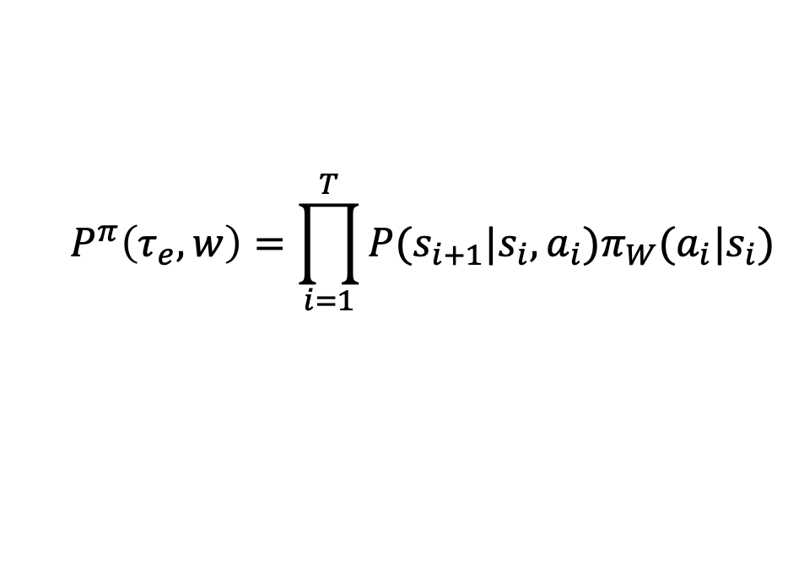
Probability of Generating an Episode
$${P^{π}\left(τ_{e},w\right)=\prod_{i=1}^{T}{P(s_{i+1}|s_{i},a_{i})π_{W}(a_{i}|s_{i})}}$$

Slide 32
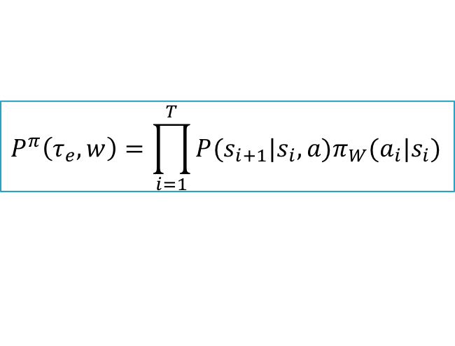
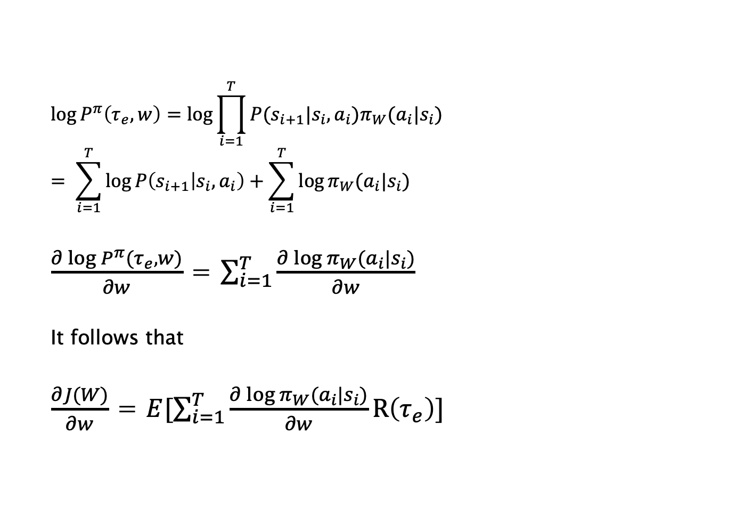
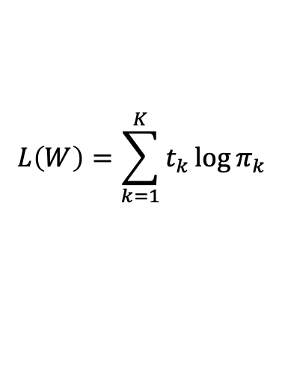
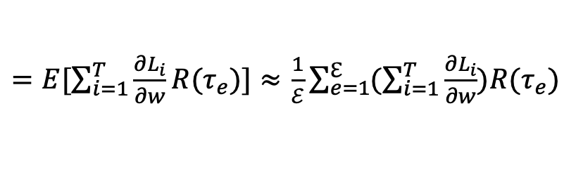
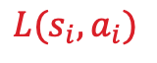
Reward Gradient can be Estimated Model Free
$$P^{π}\left(τ_{e},w\right){=\prod_{i=1}^{T}{P(s_{i+1}|s_{i},a)π_{W}(a_{i}|s_{i})}}$$
$$\log{P^{π}\left(τ_{e},w\right)=\log{\prod_{i=1}^{T}{P(s_{i+1}|s_{i},a_{i})π_{W}(a_{i}|s_{i})}}}$$
$$= \sum_{i=1}^{T}{\log{P\left(s_{i+1} | s_{i},a_{i}\right)+\sum_{i=1}^{T}{\log{π_{W}(a_{i}|s_{i})}}}}$$
$\frac{∂\log{P^{π}(τ_{e},w)}}{∂w}$ = $\sum_{i=1}^{T}{\frac{∂\log{π_{W}(a_{i}|s_{i})}}{∂w}}$
It follows that
$\frac{∂J(W)}{∂w}$ = $E[\sum_{i=1}^{T}{\frac{∂\log{π_{W}(a_{i}|s_{i})}}{∂w}}R\left(τ_{e}\right)]$
L$\left(W\right)=[t\left(j\right)\log{y\left(j\right)+\left(1−t\left(j\right)\right)\log{(1−y\left(j\right))}}$]
This step makes the Policy Gradient Algorithms Model Free!!
$$L(s_{i},a_{i})$$
This gradient can potentially
be evaluated by sampling
without knowledge of the
model
$=E[\sum_{i=1}^{T}{\frac{∂L_{i}}{∂w}R(τ_{e})]}≈$ $\frac{1}{ℰ}\sum_{e=1}^{ℇ}{(\sum_{i=1}^{T}{\frac{∂L_{i}}{∂w}})R(τ_{e})}$
$$L\left(W\right)=\sum_{k=1}^{K}{t_{k}\log{π_{k}}}$$

Slide 33
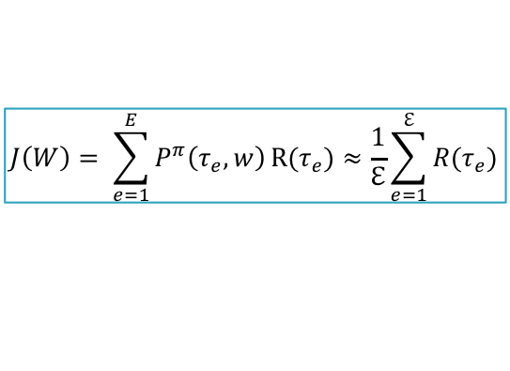
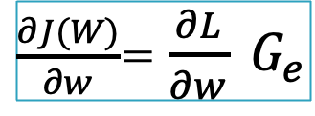
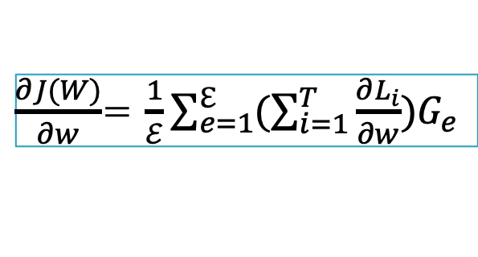
Monte Carlo Policy Gradients: Reinforce
w$←w+ηG\frac{∂L}{∂w}$
$$J\left(W\right)= \sum_{e=1}^{E}{P^{π}\left(τ_{e},w\right)}R(τ_{e})≈\frac{1}{ℇ}\sum_{e=1}^{ℇ}{R(τ_{e})}$$
Episode 1: Actions are chosen
according to
Policy $π1$
Episode 2: Actions are chosen
according to
Improved Policy $π2$
$\frac{∂J(W)}{∂w}$= $\frac{1}{ℰ}\sum_{e=1}^{ℇ}{(\sum_{i=1}^{T}{\frac{∂L_{i}}{∂w}})G_{e}}$
$\frac{∂J(W)}{∂w}$= $\frac{∂L}{∂w} G_{e}$
Full Gradient Descent
Stochastic Gradient Descent

Slide 34
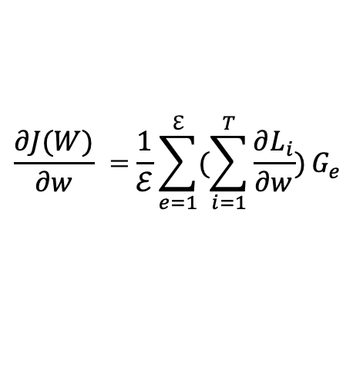
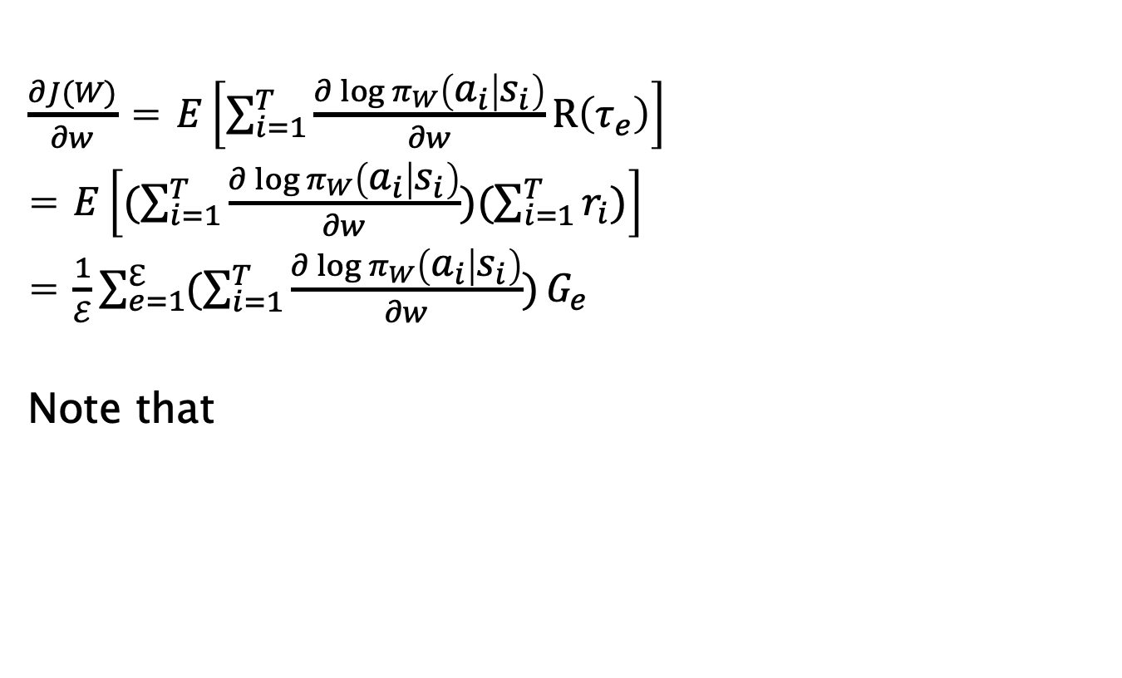
An Expression for the Policy Gradient
$\frac{∂J(W)}{∂w}$ = $E\left[\sum_{i=1}^{T}{\frac{∂\log{π_{W}\left(a_{i} | s_{i}\right)}}{∂w}}R\left(τ_{e}\right)\right]$
= $E\left[(\sum_{i=1}^{T}{\frac{∂\log{π_{W}\left(a_{i} | s_{i}\right)}}{∂w}})(\sum_{i=1}^{T}{r_{i})}\right]$
= $\frac{1}{ℰ}\sum_{e=1}^{ℇ}{(\sum_{i=1}^{T}{\frac{∂\log{π_{W}\left(a_{i} | s_{i}\right)}}{∂w}})}G_{e}$
Note that
This can be used as the basis of an algorithm
$$\log{π_{W}\left(a_{i} | s_{i}\right)}=Cross Entropy L, evaluated at Label corresponding to action ai=Li$$
$$\frac{∂J(W)}{∂w}\text{ =}\frac{1}{ℰ}\sum_{e=1}^{ℇ}{(\sum_{i=1}^{T}{\frac{∂L_{i}}{∂w}})}G_{e}$$
$$π\left(a_{1},s,w\right)$$
S
$$π\left(a_{K},s,w\right)$$

Slide 35
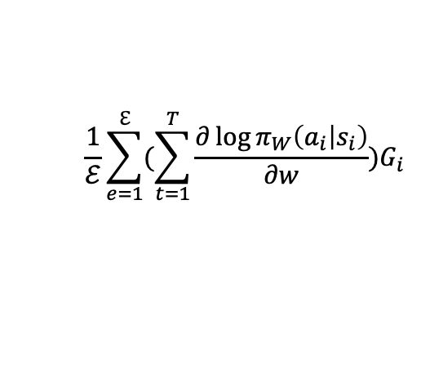
The Reinforce Algorithm: Batch Mode
$$\frac{1}{ℰ}\sum_{e=1}^{ℇ}{(\sum_{t=1}^{T}{\frac{∂\log{π_{W}\left(a_{i} | s_{i}\right)}}{∂w}})G_{i}}$$

Slide 36

The Reinforce Algorithm
$$\frac{∂L_{i}}{∂w} G_{e}$$
How to compute gradients ?

Slide 37

Monte Carlo Policy Gradients: Reinforce
w$←w+η\frac{∂J}{∂w}$= $w+ηG\frac{∂L}{∂w}$
Use these actions as labels to train Policy Network
a₁
Episode 1: Actions are chosen
according to
Policy $π1$
a₂
Episode 2: Actions are chosen
according to
Improved Policy $π2$
a₃
$$π\left(a_{1},s,w\right)$$
$G_{i}=\sum_{j=1}^{T}{R_{j}}$ : The total reward for the episode
S
$$π\left(a_{K},s,w\right)$$
If G for the episode is positive, then increase the probability of taking all actions in the episode and vice versa

Slide 38


The case of K = 2
$$\frac{∂L}{∂w} G_{e}$$
$$w_{i}←\left\{\begin{aligned}w_{i}+ηx_{i}\left(S\right)G\left(S\right)[1−y\left(S\right)], if A=1 \\ w_{i}−ηx_{i}\left(S\right)G\left(S\right)y\left(S\right), if A=0\end{aligned}\right.$$
Where A is the Action that the Agent takes in State S
And G(S) is the Total Reward for Episode

Slide 39


The case of K > 2
$$w_{ik}←\left\{\begin{aligned}w_{ik}+ηx_{i}\left(S\right)G\left(S\right)[1−y_{k}\left(S\right)], if k=A \\ w_{ik}−ηx_{i}\left(S\right)G\left(S\right)y_{k}\left(S\right), if k≠A\end{aligned}\right.$$
Where A is the Action that the Agent takes in State S
And G(S) is the Total Reward for Episode

Slide 40

Gradient Computation in Supervised Learning
Computes $L=\sum_{k=1}^{K}{t_{k}\log{π_{k}}}$

Slide 41


Gradient Computation in Policy Gradients
Computes $L=\sum_{k=1}^{K}{t_{k}\log{π_{k}}}$
Computes $L=(\sum_{i=1}^{M}{r_{i}})\sum_{k=1}^{K}{t_{k}\log{π_{k}}}$

Slide 42
Issues
High Variance
The algorithm takes a long time to converge
It is an On-Policy algorithm: Existing training data cannot be reused

Slide 43
Variance Reduction

Slide 44
Techniques for Variance Reduction
Discounting
Exploiting Causality: Reward to-go
Baselines
Actor-Critic Algorithms

Slide 45

Discounting
$$G_{e}=\sum_{j=1}^{T}{β^{i}R^{j}}$$
Give more weight to Actions that occur near Reward

Slide 46



Exploiting Causality: Reward To-Go
$\frac{∂J(W)}{∂w}$= $\frac{1}{ℰ}\sum_{e=1}^{ℰ}{(\sum_{i=1}^{T}{\frac{∂L_{i}}{∂w}})(\sum_{i=1}^{T}{R_{i})}}$
Observation: Action taken at time i can only influence the rewards
from i onwards
$\frac{∂J(W)}{∂w}$= $\frac{1}{ℰ}\sum_{e=1}^{ℰ}{\sum_{i=1}^{T}{\frac{∂\log{π_{i}}}{∂w}}\sum_{j=i}^{T}{R_{j}}}$
$\frac{∂J(W)}{∂w}$= $\frac{1}{ℰ}\sum_{e=1}^{ℰ}{\sum_{i=1}^{T}{\frac{∂\log{π_{i}}}{∂w}}G_{i}}$

Slide 47

Monte Carlo Policy Gradients: Reinforce
w$←w+η\frac{∂J}{∂w}$= $w+ηG\frac{∂L}{∂w}$
Use these actions as labels to train Policy Network
a₁
Episode 1: Actions are chosen
according to
Policy $π1$
a₂
Episode 2: Actions are chosen
according to
Improved Policy $π2$
a₃
$$π\left(a_{1},s,w\right)$$
$G_{i}=\sum_{j=i}^{T}{R_{j}}$ : The total reward from step i onwards
S
$$π\left(a_{K},s,w\right)$$
If G_{i} for action a_{i} is positive, then increase the probability of taking that action and vice versa

Slide 48



Baselines
$\frac{∂J(W)}{∂w}$= $\frac{1}{ℰ}\sum_{e=1}^{ℰ}{\sum_{i=1}^{T}{\frac{∂L_{i}}{∂w}}G_{i}}$
Instead of
$\frac{∂J(W)}{∂w}$= $\frac{1}{ℰ}\sum_{e=1}^{ℰ}{\sum_{i=1}^{T}{\frac{∂L_{i}}{∂w}}{(G}_{i}−b)}$
Do this
We are only interested in how good the reward is compared to its average value,
not its absolute value.
$$b=\frac{1}{M}\sum_{i=1}^{Tℰ}{G_{i}}$$
Is Baselining allowed?

Slide 49

Proof
$$\frac{∂J(W)}{∂w} =E\left[\frac{∂logP^{π}\left(τ_{e},w\right)}{∂w}(R\left(τ_{e}\right)−b)\right]$$
$$E\left[\frac{∂logP^{π}\left(τ_{e},w\right)}{∂w}b\right]=\int{P^{π}\left(τ_{e},w\right)\frac{∂logP^{π}\left(τ_{e},w\right)}{∂w}b}$$
$=\int{\frac{∂P^{π}\left(τ_{e},w\right)}{∂w}}b=b\frac{∂}{∂w}\int{P^{π}\left(τ_{e},w\right)=b}$ $\frac{∂(1)}{∂w}$=0
i.e. $\frac{∂J(W)}{∂w} =E\left[\frac{∂logP^{π}\left(τ_{e},w\right)}{∂w}(R\left(τ_{e}\right)−b)\right]$= $E\left[\frac{∂logP^{π}\left(τ_{e},w\right)}{∂w}R\left(τ_{e}\right)\right]$

Slide 50




Baseline Choices
$\frac{∂J(W)}{∂w}$ = $E\left[\sum_{i=1}^{M}{\frac{∂\log{π (a_{i}|S_{i})}}{∂w}(G_{i}−b\left(S_{i}\right))}\right]$
Baseline can be a function of S in general
$$b=\frac{1}{M}\sum_{i=1}^{Tℰ}{G_{i}}$$
1)
(a constant)
2)
$\frac{∂J(W)}{∂w}$ = $E\left[\sum_{i=1}^{M}{\frac{∂\log{π (a_{i}|S_{i})}}{∂w}(G_{i}−v_{π}\left(S_{i}\right))}\right]$

Slide 51
Actor-Critic Algorithms

Slide 52


What Problem Are We Solving?
Monte Carlo Policy Gradients work only for systems with terminating episodes.
What about systems in which the episodes do not terminate?
How can we further reduce the variance
$\frac{∂J(W)}{∂w}$= $\frac{1}{ℰ}\sum_{e=1}^{ℰ}{\sum_{i=1}^{T}{\frac{∂\log{π_{W}\left(a_{i} | s_{i}\right)}}{∂w}}(R_{i}(s_{i},a_{i})+R_{i+1}(s_{i+1},a_{i+1})+…+R_{T}(s_{T},a_{T}))}$
Variance is high due to the sum of the rewards.
$\frac{∂J(W)}{∂w}$= $\frac{1}{ℰ}\sum_{e=1}^{ℰ}{\sum_{i=1}^{T}{\frac{∂\log{π_{W}\left(a_{i} | s_{i}\right)}}{∂w}} q_{π}(s_{i},a_{i})}$
Replace with Average Value!

Slide 53


(Re) Introducing the Q Function!
$\frac{∂J(W)}{∂w}$= $\frac{1}{ℰ}\sum_{e=1}^{ℰ}{\sum_{i=1}^{T}{\frac{∂\log{π_{W}\left(a_{i} | s_{i}\right)}}{∂w}} q_{π}(s_{i},a_{i})}$
Monte Carlo evaluation of $Q_{π}(s_{i},a_{i}$)

Slide 54


What about the Baseline
$\frac{∂J(W)}{∂w}$= $\frac{1}{ℰ}\sum_{e=1}^{ℰ}{\sum_{i=1}^{T}{\frac{∂\log{π_{W}\left(a_{i} | s_{i}\right)}}{∂w}} [q_{π}\left(s_{i},a_{i}\right)−v_{π}\left(s_{i}\right)]}$
Recall Bellman Expectation Equation:
$$v_{π}\left(s_{i}\right)=\sum_{j=1}^{K}{π\left(a_{j} | s_{i}\right)}q_{π}(s_{i},a_{j})$$
Answers the question:
If in state s_{i} I take action a_{i}, then how much better is this reward compared to the average reward over all actions?

Slide 55


The Advantage Function
Define the Advantage Function as
$$A_{π}\left(s_{i},a_{i}\right)=q_{π}\left(s_{i},a_{i}\right)−v_{π}\left(s_{i}\right)$$
$\frac{∂J(W)}{∂w}$= $\frac{1}{ℰ}\sum_{e=1}^{ℰ}{\sum_{i=1}^{T}{\frac{∂\log{π_{W}\left(a_{i} | s_{i}\right)}}{∂w}}A_{π}\left(s_{i},a_{i}\right)}$
The better this estimate, the lower
the variance

Slide 56


Estimating the Advantage Function
Note that
$$A_{π}\left(s,a \right)=q_{π}\left(s,a \right)−v_{π}\left(s\right)$$
Since
$q_{π}\left(s,a \right)$=R$\left(s,a\right)+\sum_{s′}{P(s^{′}|s,a)v_{π}(s^{′})}$
Approximately (along the sample path s,a,r,s’)
$$q_{π}\left(s,a \right)≈R\left(s,a\right)+v_{π}(s^{′})$$
So that
$A_{π}\left(s,a \right)≈R\left(s,a\right)+v_{π}(s^{′})$-$v_{π}(s)$
From this equation it would seem that we need to estimate both $q_{π}$ and $v_{π}$ to estimate $A_{π}$.
However …
The Advantage Function can be estimated through just the Value Function

Slide 57

Estimating the Value Function with Neural Networks
s
$$V_{π}\left(S,W′\right)$$
Two Techniques to train the Neural Network model:
Monte Carlo
Temporal Difference

Slide 58

Value Function Estimation using Monte Carlo
$w_{j}←w_{j}−ηx_{j}(i)[V\left(S_{i},W\right)−G\left(S_{i}\right)$]
Update made at end of an Episode

Slide 59

Value Function Estimation using Temporal Difference
$w_{j}←w_{j}−ηx_{j}[V\left(S,W\right)−(R+γV(S′,W)$]
Update made at every step (S, A, R, S’)

Slide 60







Overall System: Online Actor Critic
Actor
$$π\left(a_{1},S,W\right)$$
S
In state S
Run Actor to Generate next Action A
$$π\left(a_{K},S,W\right)$$
Critic
s
$$v_{π}\left(S,W′\right)$$
Take a step in the environment
to generate reward R and next state S’
$$target=R+V_{π}(S^{′},W^{′})$$
Use (S,A,R,S’) to update the Critic’s Neural Network parameters.
$$A_{π}\left(S,a\right)=R+V_{π}\left(S^{′},W′\right)−V_{π}(S,W^{′})$$
Use $V_{π}\left(S,W^{′}\right)$to update the Actor’s neural Network Parameters
Set S’ ← S
$$\frac{∂J(W)}{∂W}=\frac{∂\log{π_{w}\left(S,a\right)}}{∂W}A_{π}(S,W^{′})$$

Slide 61
Online Actor-Critic Algorithm

Slide 62
Batch Actor-Critic Algorithm

Slide 63
Adding Discount

Slide 64
Continuous Action Spaces: Deterministic Policy Gradients

Slide 65

Continuous Action Spaces
Instead of generating probabilities of Actions
Generate the Optimal Action directly!
S
A

Slide 66
Continuous Action Spaces
Generate the Optimal Action directly!
S
A
How to train the Policy Network for continuous Actions?
Hint: The Optimal Action is the one that maximizes the Q Function
Idea: Use the Q Function as the Reward to train the Policy Network
Optimal
Action
Q(S,A)
A*

Slide 67


DPG Algorithm
S
Critic
Network 1
W₁
Q(S,A,W₁)
A
Actor
S’
Network 2
W₂
A(S’,W₂)
Choose the Action that maximizes Q(S,A,W₁)
Use Q(S,A,W₁) as the Reward Function for Network 2
$$W2←W2+η\frac{∂Q(S,A,W1)}{∂W2}$$
$\frac{∂Q(S,A,W1)}{∂W2}$ = $\frac{∂Q(S,A,W1)}{∂A}$ $\frac{∂A(S′,W2)}{∂W2}$

Slide 68
DPG Algorithm
1. Choose Action A using Network 2
2. Take a step in the env and obtain the (S,A,R,S’) values
3. Choose the next Action A’ using Network 2
4. Improve the Q Value by improving Network 1
5. Improve the Action by improving Network 2 (Policy Improvement Step)

Slide 69
Continuous Action Spaces: Deterministic Policy Gradients (DPG)
$w_{jk}←w_{jk}−ηx_{j}[Q\left(S,A_{k},W\right)−(R+γ\max_{A^{′}}{Q(S′, }A^{′},W))$]

Slide 70
DPG Algorithm

Slide 71
DPG Algorithm

Slide 72
Gradient Computations

Slide 73



Gradient Computations
Let ${ π}_{j}=π_{W}(a_{j}|s)$
Define
$$ℛ=G\sum_{k=1}^{K}{t_{k}\log{π_{k}}}, where t_{j}=1 if k=q and 0 otherwise$$
Then
$ℛ=G log π_{q}$ and
$$\frac{∂ℛ}{∂w}=G\frac{∂\log{π_{q}}}{∂w}$$
q: The action actually taken
Cross Entropy Function: This is well known
from Logistic Regression
$$π\left(a_{1},s,w\right)$$
s
$$π\left(a_{K},s,w\right)$$
Target = (t₁,t₂,…,t_{K})

Slide 74



Gradient Computations
$$\frac{∂ℛ}{∂A_{k}}=G\sum_{j=1}^{K}{\frac{∂ℛ}{∂π_{j}}\frac{∂π_{j}}{∂A_{k}}}=G\frac{∂ℛ}{∂π_{k}}\frac{∂π_{k}}{∂A_{k}}+G\sum_{j≠k}{\frac{∂ℛ}{∂π_{j}}\frac{∂π_{j}}{∂A_{k}}}$$
= G$\frac{t_{k}}{π_{k}}π_{k}\left(1−π_{k}\right)+$ G$\sum_{j≠k}{\frac{t_{j}}{π_{j}}}$(-$π_{j}π_{k})$
$={G t}_{k}\left(1−π_{k}\right)−G\sum_{j≠k}{t_{j}π_{k}}$ = G($t_{k}−π_{k}$)
$$\frac{∂ℛ}{∂A_{k}}=\left\{\begin{aligned}G\left(1−π_{q}\right), k=q \\ {−Gπ}_{k}, k≠q \end{aligned}\right.$$
$$π_{1}$$
_{A1}
.
.
.
.
_{A2}
S
w
_{AK}
$$π_{K}$$
Logits

Slide 75



Gradient Computations: Linear System
$$π_{1}$$
x₁
_{A1}
$$\frac{∂ℛ}{∂A_{k}}=\left\{\begin{aligned}G(1−π_{q}), k=q \\ {−Gπ}_{j}, k≠q \end{aligned}\right.$$
$$If { A}_{k}=\sum_{i=1}^{N}{w_{ik}x_{i}}$$
then
$\frac{∂ℛ}{∂w_{ik}}$ = $\frac{∂ℛ}{∂A_{k}}$ $\frac{∂A_{k}}{∂w_{ik}}=x_{i}$ $\frac{∂ℛ}{∂a_{k}}$
$w_{iq}←w_{iq}$+$η$ $\frac{∂ℛ}{∂w_{iq}}$= $w_{iq}+ηx_{i}G(1−π_{q})$ for k = q
$$w_{ik}←w_{ik}−η{Gx}_{i}π_{k}, for k≠q$$
x₂
_{A2}
.
.
x_{N}
_{AK}
$$π_{K}$$
This equation shows that if the q^{th} action leads to a reward of G>0
by the end of the episode, then its synapse weight is increased, while
the synapse weights of the other actions are reduced (and vice versa for G<0).

Slide 76



Gradient Computations: Linear System
$$π_{1}$$
x₁
_{A1}
$$\frac{∂ℛ}{∂A_{k}}=\left\{\begin{aligned}G(1−π_{q}), k=q \\ {−Gπ}_{j}, k≠q \end{aligned}\right.$$
$$If { A}_{k}=\sum_{i=1}^{N}{w_{ik}x_{i}}$$
then
$\frac{∂ℛ}{∂w_{ik}}$ = $\frac{∂ℛ}{∂A_{k}}$ $\frac{∂A_{k}}{∂w_{ik}}=x_{i}$ $\frac{∂ℛ}{∂a_{k}}$
$w_{iq}←w_{iq}+ηx_{i}G(1−π_{q})$ for k = q
$$w_{ik}←w_{ik}−η{Gx}_{i}π_{k}, for k≠q$$
x₂
_{A2}
.
.
x_{N}
_{AK}
$$π_{K}$$
This equation shows that if the q^{th} action leads to a reward of G>0
by the end of the episode, then its synapse weight is increased, while
the synapse weights of the other actions are reduced (and vice versa for G<0).

